Slide 1
AdviseMe
Advising made easy

Slide 2
AdviseMe
Advising system designed to help students graduate on time.
Recommends classes that are relevant to the students major and prioritizes classes that meet multiple requirements
Generates a recommended schedule by day and time
Determines what classes offered by one’s current institution would be accepted by another.

Slide 3
Use Case Analysis
User
Register
Set
Preferences
View Schedule
View
Recommended
Classes
(new user)
Look-up
Transfer Credit
Look Ahead
Email
Advisor
(returning)
Sign-In

Slide 4
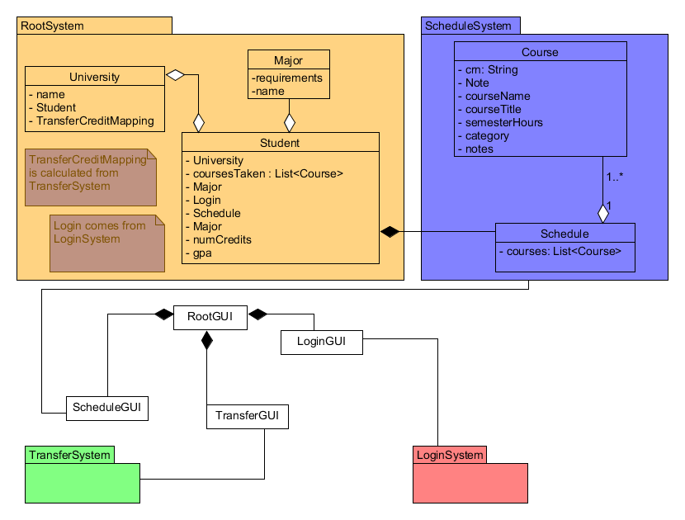
Detailed Designs and Controls

Slide 5
Systems/Algorithm Analysis
Sorts are expected to be stable even in the given limited resources, while Python uses an interpreter thanks to the nature of the Python language. Plus the number of classes to sort are expected to be in the hundreds. These are the reasons why, for now, the system use either a Merge Sort or the more complex and less memory intensive Block Sort bringing the time complexity of sorting to n log n.
Hash table is the system’s search algorithm because it is deemed the most simple and effective of the search algorithms for this project, and it is also far easier to fix compared to binary search.

Slide 6
Data Dictionary
Raw Data
Data about offered classes pulled directly from the school, is not yet formatted to be used by the system
Data about what classes are required for a major
Data concerning what courses are accepted as transfer credits
Course Data
This is the raw course data, but cleaned up for use by the system.
Required Courses by Major
Formatted raw major data, able to be used by the system
Transfer Data
Raw transfer data, but formatted for use by the system
Student courses - What courses a student has taken

